Slide 1

About the Presentations
The presentations cover the objectives found in the opening of each chapter.
All chapter objectives are listed in the beginning of each presentation.
You may customize the presentations to fit your class needs.
Some figures from the chapters are included. A complete set of images from the book can be found on the Instructor Resources disc.

Slide 2
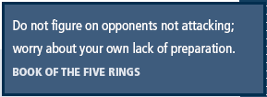
Principles of Information Security,
Fourth Edition
Chapter 1
Introduction to Information Security

Slide 3
Learning Objectives
Upon completion of this material, you should be able to:
  Define information security
  Recount the history of computer security and how it evolved into information security
  Define key terms and critical concepts of information security
  Enumerate the phases of the security systems development life cycle
  Describe the information security roles of professionals within an organization
Principles of Information Security, Fourth Edition
Notes:
Upon completion of this chapter you should be able to:
Understand what information security is and how it came to mean what it does today
Comprehend the history of computer security and how it evolved into information security
Understand the key terms and critical concepts of information security as presented in the chapter
Outline the phases of the security systems development life cycle
Understand the role of professionals involved in information security in an organizational structure

Slide 4
Introduction
Information security: a “well-informed sense of assurance that the information risks and controls are in balance.” — Jim Anderson, Inovant (2002)‏
Security professionals must review the origins of this field to understand its impact on our understanding of information security today
Principles of Information Security, Fourth Edition
Notes:
What Is Information Security?
Information security in today’s enterprise is a “well-informed sense of assurance that the information risks and controls are in balance.” – Jim Anderson, Inovant (2002)‏
Before we can begin analyzing the details of information security, it is necessary to review the origins of this field and its impact on our understanding of information security today.

Slide 5
The History of Information Security
Computer security began immediately after the first mainframes were developed
  Groups developing code-breaking computations during World War II created the first modern computers
  Multiple levels of security were implemented
Physical controls to limit access to sensitive military locations to authorized personnel
Rudimentary in defending against physical theft, espionage, and sabotage
Principles of Information Security, Fourth Edition
Notes:
The History Of Information Security
The need for computer security, or the need to secure the physical location of hardware from outside threats, began almost immediately after the first mainframes were developed.
Groups developing code-breaking computations during World War II created the first modern computers .
Badges, keys, and facial recognition of authorized personnel controlled access to sensitive military locations.
In contrast, information security during these early years was rudimentary and mainly composed of simple document classification schemes.
There were no application classification projects for computers or operating systems at this time, because the primary threats to security were physical theft of equipment, espionage against the products of the systems, and sabotage.

Slide 6
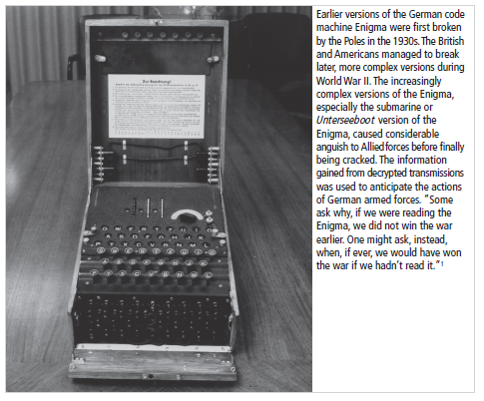
Figure 1-1 – The Enigma
Figure 1-1 The Enigma
Source: Courtesy of National Security Agency
Principles of Information Security, Fourth Edition
Notes:
This picture is not topical to the chapter except to show a high-visibility artifact associated with a subtopic of information security. More properly, this is an artifact that is part of the study of cryptography from Chapter 8 and the Appendix.

Slide 7
The 1960s
Advanced Research Project Agency (ARPA) began to examine feasibility of redundant networked communications
Larry Roberts developed ARPANET from its inception
Principles of Information Security, Fourth Edition
Notes:
The 1960s
During the 1960s, the Department of Defense’s Advanced Research Procurement Agency (ARPA) began examining the feasibility of a redundant networked communications system designed to support the military’s need to exchange information.
Larry Roberts, known as the founder of the Internet, developed the project from its inception.

Slide 8
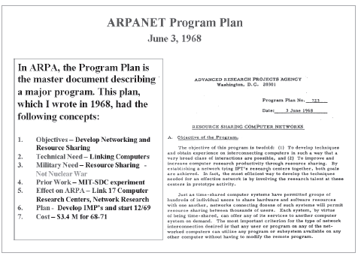
Figure 1-2 - ARPANET
Figure 1-2 Development of the ARPANET Program Plan³
Source: Courtesy of Dr. Lawrence Roberts
Principles of Information Security, Fourth Edition
Notes:
Founding document from the ARPANET.

Slide 9
The 1970s and 80s
ARPANET grew in popularity as did its potential for misuse
Fundamental problems with ARPANET security were identified
  No safety procedures for dial-up connections to ARPANET
  Nonexistent user identification and authorization to system
Late 1970s: microprocessor expanded computing capabilities and security threats
Principles of Information Security, Fourth Edition
Notes:
The 1970s and 80s
During the next decade, the ARPANET grew in popularity and use, and so did its potential for misuse.
In December of 1973, Robert M. Metcalfe indicated that there were fundamental problems with ARPANET security.
Individual remote users’ sites did not have sufficient controls and safeguards to protect data against unauthorized remote users.
There were no safety procedures for dial-up connections to the ARPANET.
User identification and authorization to the system were nonexistent.
Phone numbers were widely distributed and openly publicized on the walls of rest rooms and phone booths, giving hackers easy access to ARPANET.
Much of the focus for research on computer security centered on a system called MULTICS (Multiplexed Information and Computing Service).
In mid-1969, not long after the restructuring of the MULTICS project, several of the key players created a new operating system called UNIX.
While the MULTICS system had planned security with multiple security levels and passwords, the UNIX system did not.
In the late 1970s the microprocessor brought in a new age of computing capabilities and security threats as these microprocessors were networked.

Slide 10
The 1970s and 80s (cont’d.)‏
Information security began with Rand Report R-609 (paper that started the study of computer security)‏
Scope of computer security grew from physical security to include:
  Safety of data
  Limiting unauthorized access to data
  Involvement of personnel from multiple levels of an organization
Principles of Information Security, Fourth Edition
Notes:
The Paper that Started the Study of Computer Security
It began with Rand Report R-609, sponsored by the Department of Defense, which attempted to define multiple controls and mechanisms necessary for the protection of a multilevel computer system.
The scope of computer security grew from physical security to include:
Safety of the data itself
Limiting of random and unauthorized access to that data
Involvement of personnel from multiple levels of the organization
At this stage, the concept of computer security evolved into the more sophisticated system we call information security.

Slide 11
MULTICS
Early focus of computer security research was a system called Multiplexed Information and Computing Service (MULTICS)‏
First operating system created with security as its primary goal
Mainframe, time-sharing OS developed in mid-1960s by General Electric (GE), Bell Labs, and Massachusetts Institute of Technology (MIT)‏
Several MULTICS key players created UNIX
Primary purpose of UNIX was text processing
Principles of Information Security, Fourth Edition
Notes:
The Paper that Started the Study of Computer Security (continued)
It began with Rand Report R-609, sponsored by the Department of Defense, which attempted to define multiple controls and mechanisms necessary for the protection of a multilevel computer system.
The scope of computer security grew from physical security to include:
Safety of the data itself
Limiting of random and unauthorized access to that data
Involvement of personnel from multiple levels of the organization
At this stage, the concept of computer security evolved into the more sophisticated system we call information security.

Slide 12
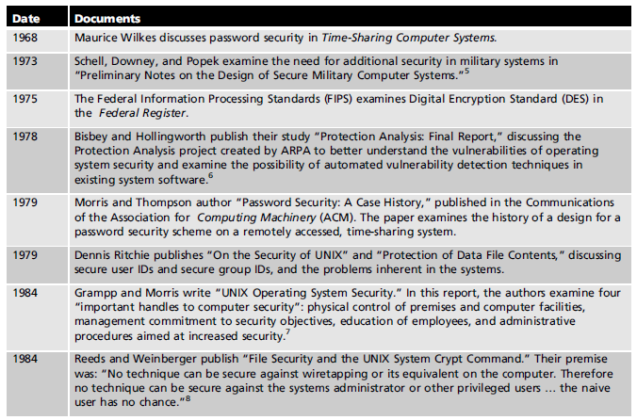
Table 1-1 Key Dates for Seminal Works in Early Computer Security
Principles of Information Security, Fourth Edition

Slide 13
The 1990s
Networks of computers became more common; so too did the need to interconnect networks
Internet became first manifestation of a global network of networks
Initially based on de facto standards
In early Internet deployments, security was treated as a low priority
Principles of Information Security, Fourth Edition
Notes:
The 1990s
At the close of the 20th century, as networks of computers became more common, so too did the need to connect the networks to each other.
This gave rise to the Internet, the first manifestation of a global network of networks.
There has been a price for the phenomenal growth of the Internet, however. When security was considered at all, early Internet deployment treated it as a low priority.
As the requirement for networked computers became the dominant style of computing, the ability to physically secure that physical computer was lost, and the stored information became more exposed to security threats.

Slide 14
2000 to Present
The Internet brings millions of computer networks into communication with each other—many of them unsecured
Ability to secure a computer’s data influenced by the security of every computer to which it is connected
Growing threat of cyber attacks has increased the need for improved security
Principles of Information Security, Fourth Edition
Notes:
The Present
Today, the Internet has brought millions of unsecured computer networks into communication with each other.
Our ability to secure each computer’s stored information is now influenced by the security on each computer to which it is connected.

Slide 15
What is Security?
“The quality or state of being secure—to be free from danger”
A successful organization should have multiple layers of security in place:
  Physical security
  Personal security
  Operations security
  Communications security
  Network security
  Information security
Principles of Information Security, Fourth Edition
Notes:
What Is Security?
In general, security is “the quality or state of being secure--to be free from danger.”
It means to be protected from adversaries--from those who would do harm, intentionally or otherwise.
A successful organization should have the following multiple layers of security in place for the protection of its operations:
Physical security – To protect the physical items, objects, or areas of an organization from unauthorized access and misuse.
Personal security – To protect the individual or group of individuals who are authorized to access the organization and its operations.
Operations security – To protect the details of a particular operation or series of activities.
Communications security – To protect an organization’s communications media, technology, and content.
Network security – To protect networking components, connections, and contents.

Slide 16
What is Security? (cont’d.)‏
The protection of information and its critical elements, including systems and hardware that use, store, and transmit that information
Necessary tools: policy, awareness, training, education, technology
C.I.A. triangle
  Was standard based on confidentiality, integrity, and availability
  Now expanded into list of critical characteristics of information
Principles of Information Security, Fourth Edition
Notes:
What Is Information Security?
Information security, therefore, is the protection of information and its critical elements, including the systems and hardware that use, store, and transmit that information.
But to protect the information and its related systems from danger, tools, such as policy, awareness, training, education, and technology are necessary.
The C.I.A. triangle has been considered the industry standard for computer security since the development of the mainframe. It was solely based on three characteristics that described the utility of information: confidentiality, integrity, and availability.
The C.I.A. triangle has expanded into a list of critical characteristics of information.

Slide 17
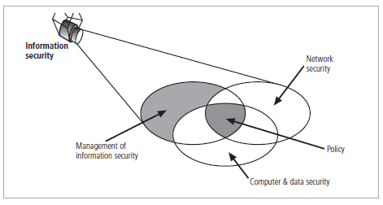
Figure 1-3 Components of Information Security
Principles of Information Security, Fourth Edition

Slide 18
Key Information Security Concepts
Access
Asset
Attack
Control, Safeguard, or Countermeasure
Exploit
Exposure
Loss
Protection Profile or Security Posture
Risk
Subjects and Objects
Threat
Threat Agent
Vulnerability
Principles of Information Security, Fourth Edition
Notes:
Key Terms
Access - a subject or object’s ability to use, manipulate, modify, or affect another subject or object.
Asset - the organizational resource that is being protected.
Attack - an act that is an intentional or unintentional attempt to cause damage or compromise to the information and/or the systems that support it.
Control, Safeguard, or Countermeasure - security mechanisms, policies, or procedures that can successfully counter attacks, reduce risk, resolve vulnerabilities, and otherwise improve the security within an organization.
Exploit - to take advantage of weaknesses or vulnerability in a system.
Exposure - a single instance of being open to damage.
Hack - Good: to use computers or systems for enjoyment; Bad: to illegally gain access to a computer or system.
Object - a passive entity in the information system that receives or contains information.
Risk - the probability that something can happen.
Security Blueprint - the plan for the implementation of new security measures in the organization.
Security Model - a collection of specific security rules that represents the implementation of a security policy.
Security Posture or Security Profile - a general label for the combination of all policies, procedures, technologies, and programs that make up the total security effort currently in place.
Subject - an active entity that interacts with an information system and causes information to move through the system for a specific end purpose
Threats - a category of objects, persons, or other entities that represents a potential danger to an asset.
Threat Agent - a specific instance or component of a more general threat.
Vulnerability - weaknesses or faults in a system or protection mechanism that expose information to attack or damage.

Slide 19
Key Information Security Concepts (cont’d.)
Computer can be subject of an attack and/or the object of an attack
  When the subject of an attack, computer is used as an active tool to conduct attack
  When the object of an attack, computer is the entity being attacked
Principles of Information Security, Fourth Edition
Notes:
Key Information Security Concepts
When considering the security of information systems components, it is important to understand the concept of the computer as the subject of an attack as opposed to the computer as the object of an attack.
When a computer is the subject of an attack, it is used as an active tool to conduct the attack. When a computer is the object of an attack, it is the entity being attacked.

Slide 20
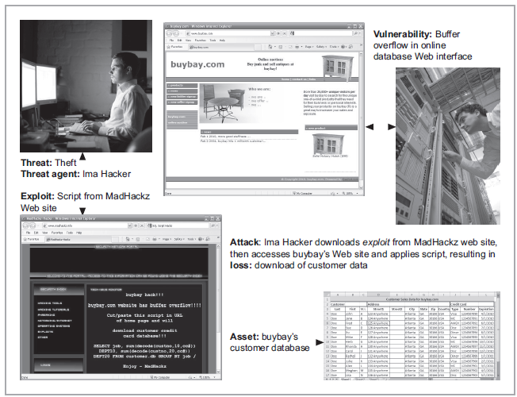
Figure 1-4 Information Security Terms
Principles of Information Security, Fourth Edition

Slide 21
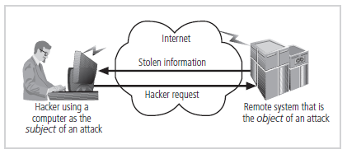
Figure 1-5 – Subject and Object of Attack
Figure 1-5 Computer as the Subject and Object of an Attack
Principles of Information Security, Fourth Edition
Notes:
It is important to note that the same computer can be both the subject and object of an attack, especially in multiuser systems.

Slide 22
Critical Characteristics of Information
The value of information comes from the characteristics it possesses:
  Availability
  Accuracy
  Authenticity
  Confidentiality
  Integrity
  Utility
  Possession
Principles of Information Security, Fourth Edition
Notes:
Critical Characteristics of Information
The value of information comes from the characteristics it possesses.
Availability – Enables users who need to access information to do so without interference or obstruction and in the required format. The information is said to be available to an authorized user when and where needed and in the correct format.
Accuracy – Free from mistake or error and having the value that the end user expects. If information contains a value different from the user’s expectations due to the intentional or unintentional modification of its content, it is no longer accurate.
Authenticity –The quality or state of being genuine or original, rather than a reproduction or fabrication. Information is authentic when it is the information that was originally created, placed, stored, or transferred.
Confidentiality – The quality or state of preventing disclosure or exposure to unauthorized individuals or systems.
Integrity – The quality or state of being whole, complete, and uncorrupted. The integrity of information is threatened when the information is exposed to corruption, damage, destruction, or other disruption of its authentic state.
Utility – The quality or state of having value for some purpose or end. Information has value when it serves a particular purpose. This means that if information is available, but not in a format meaningful to the end user, it is not useful.
Possession – The quality or state of having ownership or control of some object or item. Information is said to be in possession if one obtains it, independent of format or other characteristic. While a breach of confidentiality always results in a breach of possession, a breach of possession does not always result in a breach of confidentiality.

Slide 23
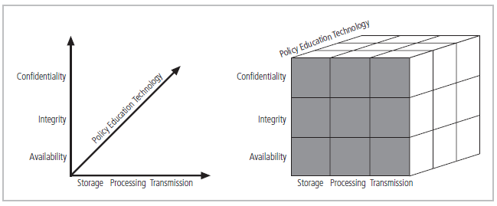
CNSS Security Model
Figure 1-6 The McCumber Cube
Principles of Information Security, Fourth Edition
Notes:
This graphic informs the fundamental approach of the chapter and can be used to illustrate the intersection of information states (x-axis), key objectives of C.I.A. (y-axis), and the three primary means to implement (policy, education, and technology).

Slide 24
Components of an Information System
Information system (IS) is entire set of components necessary to use information as a resource in the organization
  Software
  Hardware
  Data
  People
  Procedures
  Networks
Principles of Information Security, Fourth Edition
Notes:
Components of an Information System
To fully understand the importance of information security, it is necessary to briefly review the elements of an information system.
An information system (IS) is much more than computer hardware; it is the entire set of software, hardware, data, people, and procedures necessary to use information as a resource in the organization.

Slide 25
Balancing Information Security and Access
Impossible to obtain perfect security—it is a process, not an absolute
Security should be considered balance between protection and availability
To achieve balance, level of security must allow reasonable access, yet protect against threats
Principles of Information Security, Fourth Edition
Notes:
Security and Access Balancing
When considering information security, it is important to realize that it is impossible to obtain perfect security. Security is not an absolute; it is a process not a goal.
Security should be considered a balance between protection and availability.
To achieve balance, the level of security must allow reasonable access yet protect against threats.

Slide 26
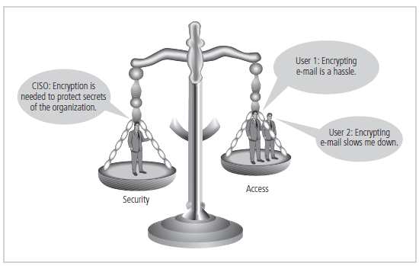
Figure 1-6 – Balancing Security and Access
Figure 1-8 Balancing Information Security and Access
Principles of Information Security, Fourth Edition
Notes:
This graphic intends to show the trade-offs between security and access.

Slide 27
Approaches to Information Security Implementation: Bottom-Up Approach
Grassroots effort: systems administrators attempt to improve security of their systems
Key advantage: technical expertise of individual administrators
Seldom works, as it lacks a number of critical features:
  Participant support
  Organizational staying power
Principles of Information Security, Fourth Edition
Notes:
Bottom-up Approach to Security Implementation
Security can begin as a grass-roots effort when systems administrators attempt to improve the security of their systems. This is referred to as the bottom-up approach.
The key advantage of the bottom-up approach is the technical expertise of the individual administrators.
Unfortunately, this approach seldom works, as it lacks a number of critical features, such as participant support and organizational staying power.

Slide 28
Approaches to Information Security Implementation: Top-Down Approach
Initiated by upper management
  Issue policy, procedures, and processes
  Dictate goals and expected outcomes of project
  Determine accountability for each required action
The most successful also involve formal development strategy referred to as systems development life cycle
Principles of Information Security, Fourth Edition
Notes:
Top-down Approach to Security Implementation
An alternative approach, which has a higher probability of success, is called the top-down approach. The project is initiated by upper management who issue policy, procedures, and processes; dictate the goals and expected outcomes of the project; and determine who is accountable for each of the required actions.
The top-down approach has strong upper-management support, a dedicated champion, dedicated funding, clear planning, and the opportunity to influence organizational culture.
The most successful top-down approach also involves a formal development strategy referred to as a systems development life cycle.

Slide 29
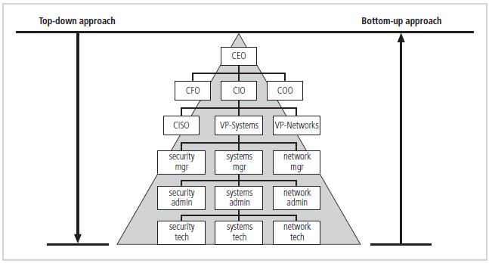
Figure 1-9 Approaches to Information Security Implementation
Principles of Information Security, Fourth Edition
Notes:
The key concept here is the direction of the left and right side arrows to show where planning is sourced and from which direction the pressure for success is driven.

Slide 30
The Systems Development Life Cycle
Systems Development Life Cycle (SDLC): methodology for design and implementation of information system within an organization
Methodology: formal approach to problem solving based on structured sequence of procedures
Using a methodology:
  Ensures a rigorous process
  Increases probability of success
Traditional SDLC consists of six general phases
Principles of Information Security, Fourth Edition
Notes:
The Systems Development Life Cycle
Information security must be managed in a manner similar to any other major system implemented in the organization.
The best approach for implementing an information security system in an organization with little or no formal security in place is to use a variation of the Systems Development Life Cycle (SDLC): the Security Systems Development Life Cycle (SecSDLC).
The SDLC is a methodology for the design and implementation of an information system in an organization.
A methodology is a formal approach to solving a problem based on a structured sequence of procedures.
Using a methodology ensures a rigorous process and avoids missing those steps that can lead to compromising the end goal.
The goal is creating a comprehensive security posture.

Slide 31
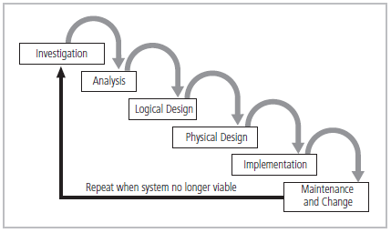
Figure 1-10 SDLC Waterfall Methodology
Principles of Information Security, Fourth Edition
Notes:
Very much a traditional SDLC diagram.

Slide 32
Investigation
What problem is the system being developed to solve?
Objectives, constraints, and scope of project are specified
Preliminary cost-benefit analysis is developed
At the end, feasibility analysis is performed to assess economic, technical, and behavioral feasibilities of the process
Principles of Information Security, Fourth Edition
Notes:
Investigation
The first phase, investigation, is the most important.
What is the problem the system is being developed to solve?
This phase begins with an examination of the event or plan that initiates the process.
The objectives, constraints, and scope of the project are specified. A preliminary cost/benefit analysis is developed to evaluate the perceived benefits and the appropriate levels of cost an organization is willing to expend to obtain those benefits.
A feasibility analysis is performed to assesses the economic, technical, and behavioral feasibilities of the process and to ensure that implementation is worth the organization’s time and effort.

Slide 33
Analysis
Consists of assessments of:
  The organization
  Current systems
  Capability to support proposed systems
Analysts determine what new system is expected to do and how it will interact with existing systems
Ends with documentation of findings and update of feasibility analysis
Principles of Information Security, Fourth Edition
Notes:
Analysis
The analysis phase begins with the information learned during the investigation phase.
This phase consists primarily of assessments of the organization, the status of current systems, and the capability to support the proposed systems.
Analysts begin to determine what the new system is expected to do and how it will interact with existing systems.
This phase ends with the documentation of the findings and a feasibility analysis update.

Slide 34
Logical Design
Main factor is business need
  Applications capable of providing needed services are selected
Data support and structures capable of providing the needed inputs are identified
Technologies to implement physical solution are determined
Feasibility analysis performed at the end
Principles of Information Security, Fourth Edition
Notes:
Logical Design
In the logical design phase, the information gained from the analysis phase is used to begin creating a solution system for a business problem.
Then, based on the business need, select applications capable of providing needed services.
Based on the applications needed, select data support and structures capable of providing the needed inputs.
Finally, based on all of the above, select specific technologies to implement the physical solution.
In the end, another feasibility analysis is performed.

Slide 35
Physical Design
Technologies to support the alternatives identified and evaluated in the logical design are selected
Components evaluated on make-or-buy decision
Feasibility analysis performed
  Entire solution presented to end-user representatives for approval
Principles of Information Security, Fourth Edition
Notes:
Physical Design
During the physical design phase, specific technologies are selected to support the alternatives identified and evaluated in the logical design.
The selected components are evaluated based on a make-or-buy decision (develop in-house or purchase from a vendor).
Final designs integrate various components and technologies.
After yet another feasibility analysis, the entire solution is presented to the end user representatives for approval.

Slide 36
Implementation
Needed software created
Components ordered, received, and tested
Users trained and documentation created
Feasibility analysis prepared
  Users presented with system for performance review and acceptance test
Principles of Information Security, Fourth Edition
Notes:
Implementation
In the implementation phase, any needed software is created or purchased
Components are ordered, received, and tested.
Afterwards, users are trained and supporting documentation is created.
Again a feasibility analysis is prepared, and the users are then presented with the system for a performance review and acceptance test.

Slide 37
Maintenance and Change
Longest and most expensive phase
Consists of tasks necessary to support and modify system for remainder of its useful life
Life cycle continues until the process begins again from the investigation phase
When current system can no longer support the organization’s mission, a new project is implemented
Principles of Information Security, Fourth Edition
Notes:
Maintenance and Change
The maintenance and change phase is the longest and most expensive phase of the process.
This phase consists of the tasks necessary to support and modify the system for the remainder of its useful life cycle.
Even though formal development may conclude during this phase, the life cycle of the project continues until it is determined that the process should begin again from the investigation phase. When the current system can no longer support the changed mission of the organization, the project is terminated and a new project is implemented.

Slide 38
The Security Systems Development Life Cycle
The same phases used in traditional SDLC may be adapted to support specialized implementation of an IS project
Identification of specific threats and creating controls to counter them
SecSDLC is a coherent program rather than a series of random, seemingly unconnected actions
Principles of Information Security, Fourth Edition
Notes:
The Security Systems Development Life Cycle
The same phases used in the traditional SDLC can be adapted to support the specialized implementation of a security project.
The fundamental process is the identification of specific threats and the creation of specific controls to counter those threats.
The SecSDLC unifies the process and makes it a coherent program rather than a series of random, seemingly unconnected actions.

Slide 39
Investigation
Identifies process, outcomes, goals, and constraints of the project
Begins with Enterprise Information Security Policy (EISP)‏
Organizational feasibility analysis is performed
Principles of Information Security, Fourth Edition
Notes:
Investigation
The investigation of the SecSDLC begins with a directive from upper management, dictating the process, outcomes, and goals of the project, as well as the constraints placed on the activity.
Frequently, this phase begins with a statement of program security policy that outlines the implementation of security.
Teams of responsible managers, employees, and contractors are organized, problems are analyzed, and scope is defined, including goals, objectives, and constraints not covered in the program policy.
Finally, an organizational feasibility analysis is performed to determine whether the organization has the resources and commitment necessary to conduct a successful security analysis and design.

Slide 40
Analysis
Documents from investigation phase are studied
Analysis of existing security policies or programs, along with documented current threats and associated controls
Includes analysis of relevant legal issues that could impact design of the security solution
Risk management task begins
Principles of Information Security, Fourth Edition
Notes:
Analysis
In the analysis phase, the documents from the investigation phase are studied.
The development team conducts a preliminary analysis of existing security policies or programs, along with documented current threats and associated controls.
This phase also includes an analysis of relevant legal issues that could impact the design of the security solution.
The risk management task – identifying, assessing and evaluating the levels of risk facing the organization – also begins in this stage.

Slide 41
Logical Design
Creates and develops blueprints for information security
Incident response actions planned:
  Continuity planning
  Incident response
  Disaster recovery
Feasibility analysis to determine whether project should be continued or outsourced
Principles of Information Security, Fourth Edition
Notes:
Logical Design
The logical design phase creates and develops the blueprints for security, and it examines and implements key policies that influence later decisions.
Also at this stage, critical planning is developed for incident response actions to be taken in the event of partial or catastrophic loss.
Next, a feasibility analysis determines whether or not the project should continue or should be outsourced.

Slide 42
Physical Design
Needed security technology is evaluated, alternatives are generated, and final design is selected
At end of phase, feasibility study determines readiness of organization for project
Principles of Information Security, Fourth Edition
Notes:
Physical Design
In the physical design phase, the security technology needed to support the blueprint outlined in the logical design is evaluated, alternative solutions are generated, and a final design is agreed upon.
The security blueprint may be revisited to keep it synchronized with the changes needed when the physical design is completed.
Criteria needed to determine the definition of successful solutions is also prepared during this phase.
Included at this time are the designs for physical security measures to support the proposed technological solutions.
At the end of this phase, a feasibility study should determine the readiness of the organization for the proposed project, and then the champion and users are presented with the design.
At this time, all parties involved have a chance to approve the project before implementation begins.

Slide 43
Implementation
Security solutions are acquired, tested, implemented, and tested again
Personnel issues evaluated; specific training and education programs conducted
Entire tested package is presented to management for final approval
Principles of Information Security, Fourth Edition
Notes:
Implementation
The implementation phase is similar to the traditional SDLC.
The security solutions are acquired (made or bought), tested, implemented, and tested again.
Personnel issues are evaluated, and specific training and education programs are conducted.
Finally, the entire tested package is presented to upper management for final approval.

Slide 44
Maintenance and Change
Perhaps the most important phase, given the ever-changing threat environment
Often, repairing damage and restoring information is a constant duel with an unseen adversary
Information security profile of an organization requires constant adaptation as new threats emerge and old threats evolve
Principles of Information Security, Fourth Edition
Notes:
Maintenance and Change
The maintenance and change phase, though last, is perhaps most important, given the high level of ingenuity in today’s threats.
The reparation and restoration of information is a constant duel with an often-unseen adversary.
As new threats emerge and old threats evolve, the information security profile of an organization requires constant adaptation to prevent threats from successfully penetrating sensitive data

Slide 45
Security Professionals and the Organization
Wide range of professionals required to support a diverse information security program
Senior management is key component
Additional administrative support and technical expertise are required to implement details of IS program
Principles of Information Security, Fourth Edition
Notes:
Security Professionals and the Organization
It takes a wide range of professionals to support a diverse information security program.
To develop and execute specific security policies and procedures, additional administrative support and technical expertise is required.

Slide 46
Senior Management
Chief Information Officer (CIO)‏
  Senior technology officer
  Primarily responsible for advising senior executives on strategic planning
Chief Information Security Officer (CISO)‏
  Primarily responsible for assessment, management, and implementation of IS in the organization
  Usually reports directly to the CIO
Principles of Information Security, Fourth Edition
Notes:
Senior Management
Chief Information Officer – The senior technology officer, although other titles such as Vice President of Information, VP of Information Technology, and VP of Systems may be used. The CIO is primarily responsible for advising the Chief Executive Officer, President, or company owner on the strategic planning that affects the management of information in the organization.
Chief Information Security Officer – The individual primarily responsible for the assessment, management, and implementation of securing the information in the organization. The CISO may also be referred to as the Manager for Security, the Security Administrator, or a similar title.

Slide 47
Information Security Project Team
A number of individuals who are experienced in one or more facets of required technical and nontechnical areas:
  Champion
  Team leader
  Security policy developers
  Risk assessment specialists
  Security professionals
  Systems administrators
  End users
Principles of Information Security, Fourth Edition
Notes:
Security Project Team
A number of individuals who are experienced in one or multiple requirements of both the technical and nontechnical areas.
The champion: A senior executive who promotes the project and ensures its support, both financially and administratively, at the highest levels of the organization.
The team leader: A project manager, who may be a departmental line manager or staff unit manager, who understands project management, personnel management, and information security technical requirements.
Security policy developers: Individuals who understand the organizational culture, policies, and requirements for developing and implementing successful policies.
Risk assessment specialists: People who understand financial risk assessment techniques, the value of organizational assets, and the security methods to be used.
Security professionals: Dedicated, trained, and well-educated specialists in all aspects of information security from both technical and nontechnical standpoints.
Systems administrators: People with the primary responsibility for administering the systems that house the information used by the organization.
End users: Those whom the new system will most directly impact. Ideally, a selection of users from various departments, levels, and degrees of technical knowledge assist the team in focusing on the application of realistic controls applied in ways that do not disrupt the essential business activities they seek to safeguard.

Slide 48
Data Responsibilities
Data owner: responsible for the security and use of a particular set of information
Data custodian: responsible for storage, maintenance, and protection of information
Data users: end users who work with information to perform their daily jobs supporting the mission of the organization
Principles of Information Security, Fourth Edition
Notes:
Data Responsibilities
Now that you understand the responsibilities of both senior management and the security project team, we can define the roles of those who own and safeguard the data.
Data Owner – Responsible for the security and use of a particular set of information. Data owners usually determine the level of data classification associated with the data, as well as changes to that classification required by organization change.
Data Custodian – Responsible for the storage, maintenance, and protection of the information. The duties of a data custodian often include overseeing data storage and backups, implementing the specific procedures and policies laid out in the security policies and plans, and reporting to the data owner.
Data Users – The end systems users who work with the information to perform their daily jobs supporting the mission of the organization. Everyone in the organization is responsible for the security of data, so data users are included here as individuals with an information security role.

Slide 49
Communities of Interest
Group of individuals united by similar interests/values within an organization
  Information security management and professionals
  Information technology management and professionals
  Organizational management and professionals
Principles of Information Security, Fourth Edition
Notes:
Communities of Interest
Each organization develops and maintains its own unique culture and values. Within that corporate culture, there are communities of interest. These include:
Information Security Management and Professionals
Information Technology Management and Professionals
Organizational Management and Professionals

Slide 50
Information Security: Is it an Art or a Science?
Implementation of information security often described as combination of art and science
“Security artesan” idea: based on the way individuals perceive systems technologists since computers became commonplace
Principles of Information Security, Fourth Edition
Notes:
Information Security: Is It an Art or a Science?
With the level of complexity in today’s information systems, the implementation of information security has often been described as a combination of art and science.
The concept of the security artesan is based on the way individuals perceived systems technologists since computers became commonplace.

Slide 51
Security as Art
No hard and fast rules nor many universally accepted complete solutions
No manual for implementing security through entire system
Principles of Information Security, Fourth Edition
Notes:
Security as Art
There are no hard and fast rules regulating the installation of various security mechanisms.
Nor are there many universally accepted complete solutions.
While there are many manuals to support individual systems, once these systems are interconnected, there is no magic user’s manual for the security of the entire system.
This is especially true with the complex levels of interaction between users, policy, and technology controls.

Slide 52
Security as Science
Dealing with technology designed to operate at high levels of performance
Specific conditions cause virtually all actions that occur in computer systems
Nearly every fault, security hole, and systems malfunction are a result of interaction of specific hardware and software
If developers had sufficient time, they could resolve and eliminate faults
Principles of Information Security, Fourth Edition
Notes:
Security as Science
We are dealing with technology developed by computer scientists and engineers—technology designed to perform at rigorous levels of performance.
Even with the complexity of the technology, most scientists would agree that specific scientific conditions cause virtually all actions that occur in computer systems.
Almost every fault, security hole, and systems malfunction is a result of the interaction of specific hardware and software.
If the developers had sufficient time, they could resolve and eliminate these faults.

Slide 53
Security as a Social Science
Social science examines the behavior of individuals interacting with systems
Security begins and ends with the people that interact with the system
Security administrators can greatly reduce levels of risk caused by end users, and create more acceptable and supportable security profiles
Principles of Information Security, Fourth Edition
Notes:
Security as a Social Science
There is a third view: security as a social science.
Social science examines the behavior of individuals as they interact with systems, whether societal systems or in our case information systems.
Security begins and ends with the people inside the organization and the people that interact with the system planned or otherwise.
End users that need the very information the security personnel are trying to protect may be the weakest link in the security chain.
By understanding some of the behavioral aspects of organizational science and change management, security administrators can greatly reduce the levels of risk caused by end users and create more acceptable and supportable security profiles.

Slide 54
Summary
Information security is a “well-informed sense of assurance that the information risks and controls are in balance”
Computer security began immediately after first mainframes were developed
Successful organizations have multiple layers of security in place: physical, personal, operations, communications, network, and information
Principles of Information Security, Fourth Edition

Slide 55
Summary (cont’d.)‏
Security should be considered a balance between protection and availability
Information security must be managed similarly to any major system implemented in an organization using a methodology like SecSDLC
Implementation of information security often described as a combination of art and science
Principals of Information Security, Fourth Edition

